Slide 1

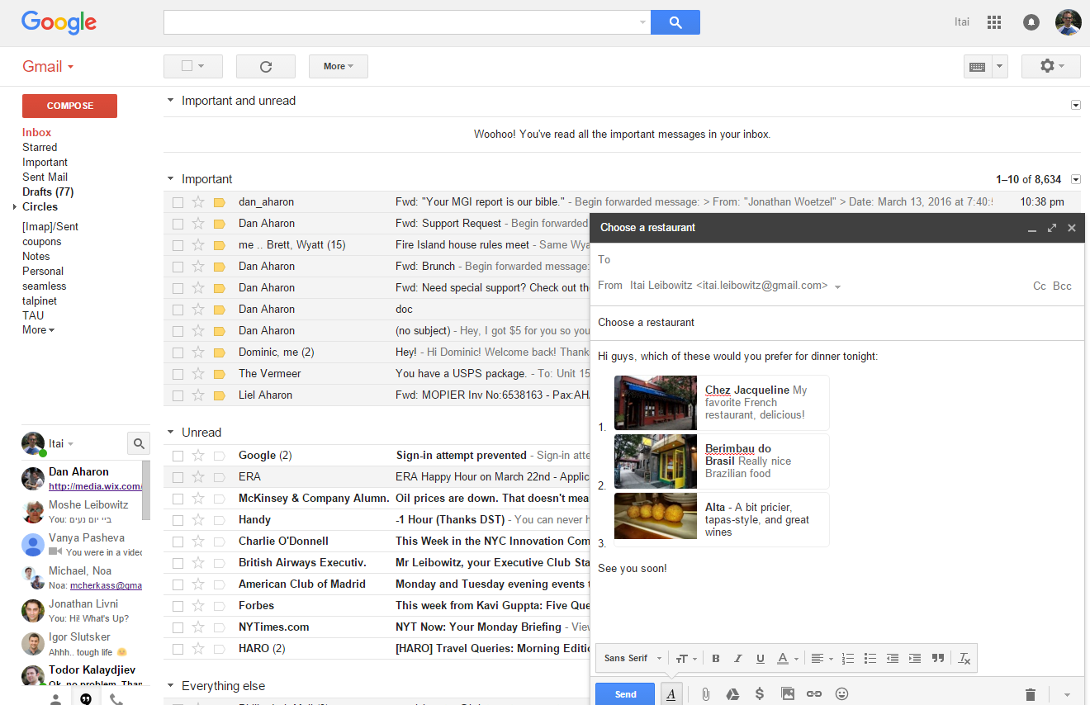
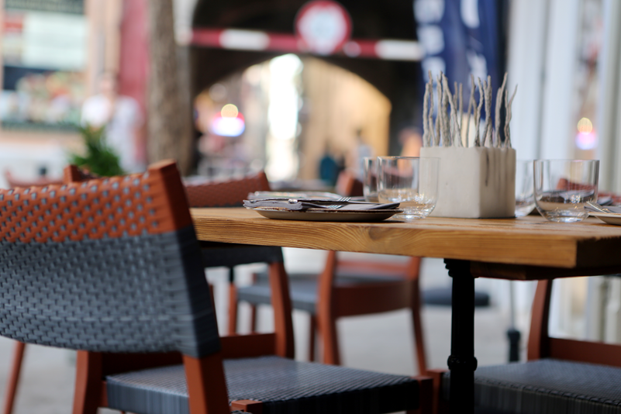

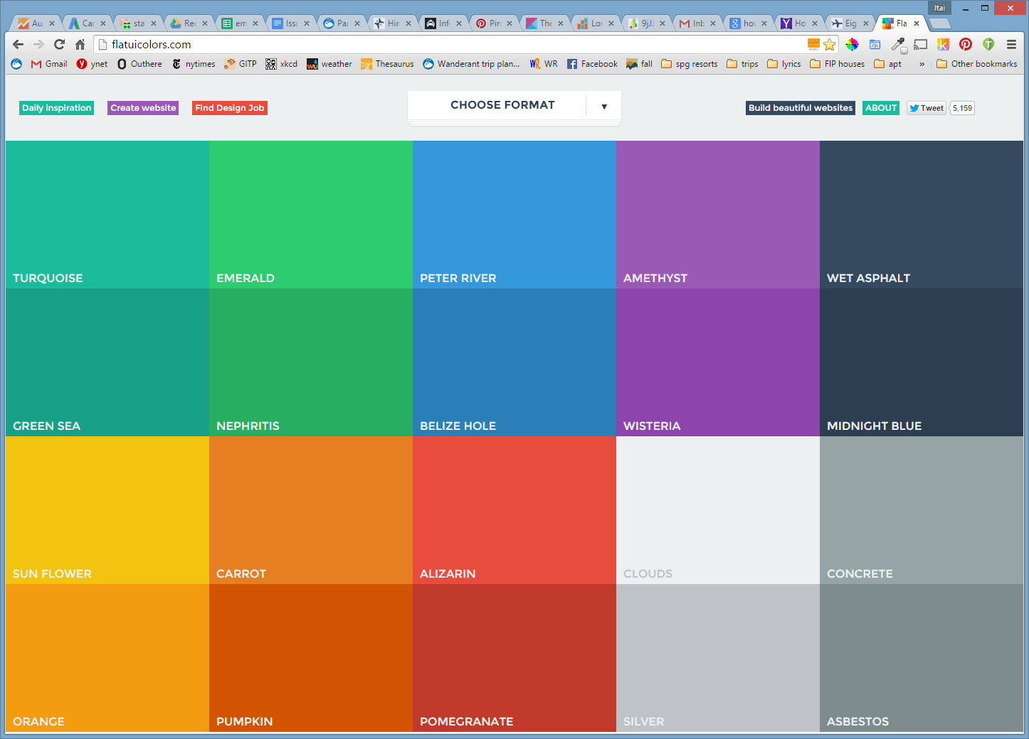
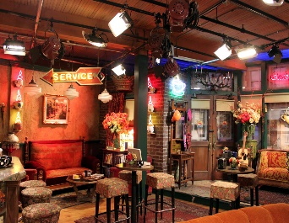

PlaceLinks
Add links to real-world places in your GmailTM messages
Home restaurant: My favorite brunch spot!
Cornelia Café:
Live shows with dinner

Slide 2
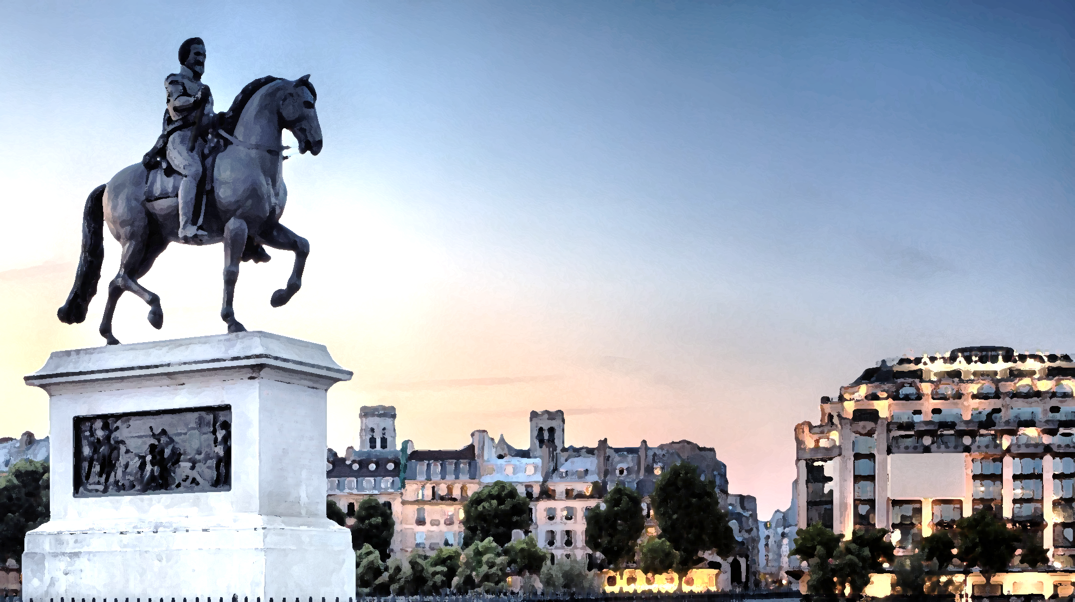

Trip Mind
Automatically organize your online trip planning

Slide 3
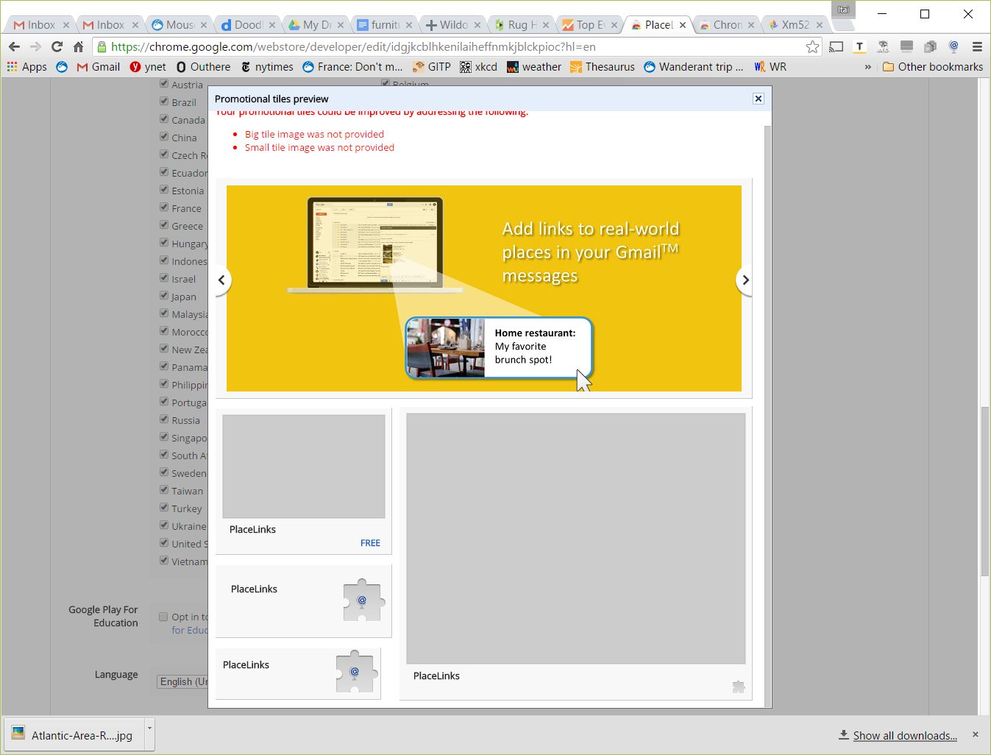

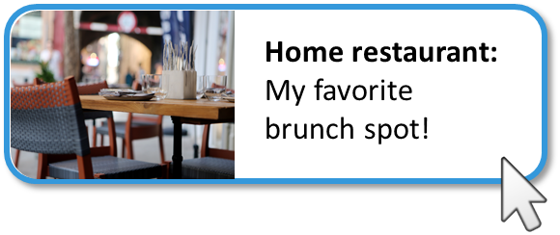
PlaceLinks
Add links to real-world places in your GmailTM messages
Trip Mind
Automatically organize your online trip planning

Slide 4
Links to real-world places in GmailTM
Trip Mind
Automatically organize your online trip planning

Slide 5
Keeps track of trip research for you.
Trip Mind

Slide 6


Trip Mind

Slide 7
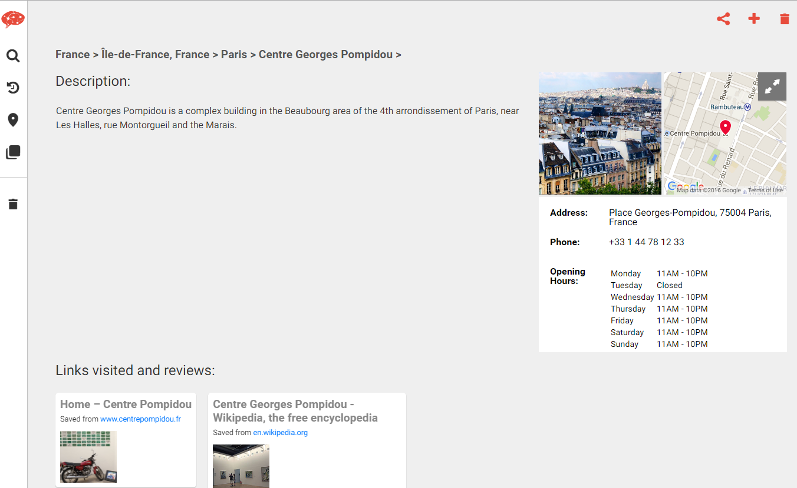

Slide 8
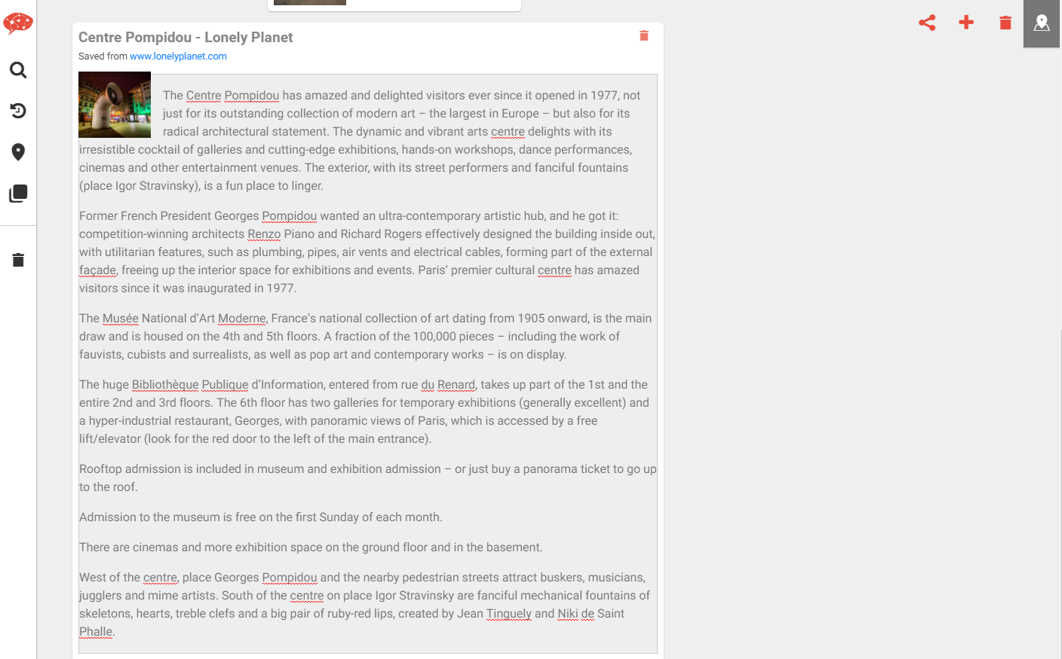

Slide 9
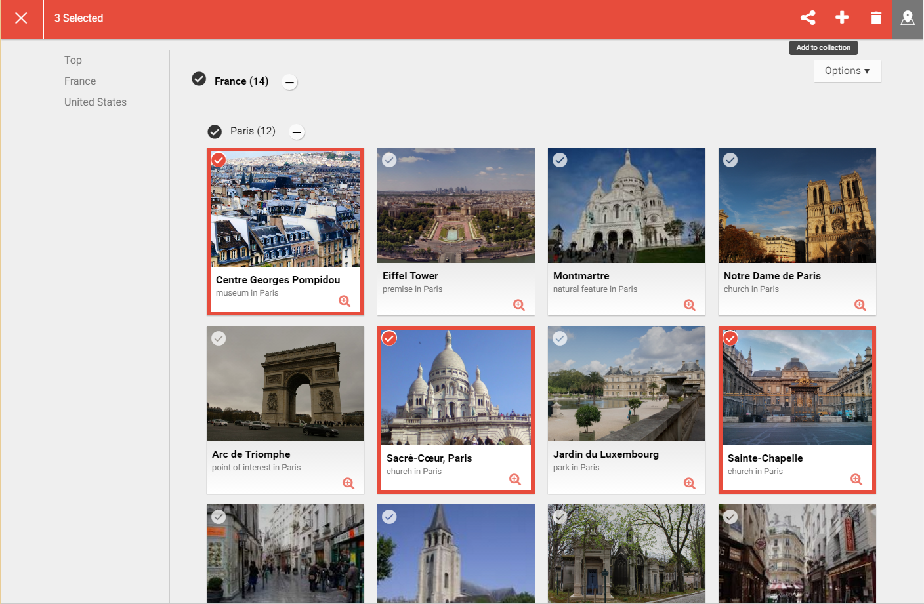

Slide 10
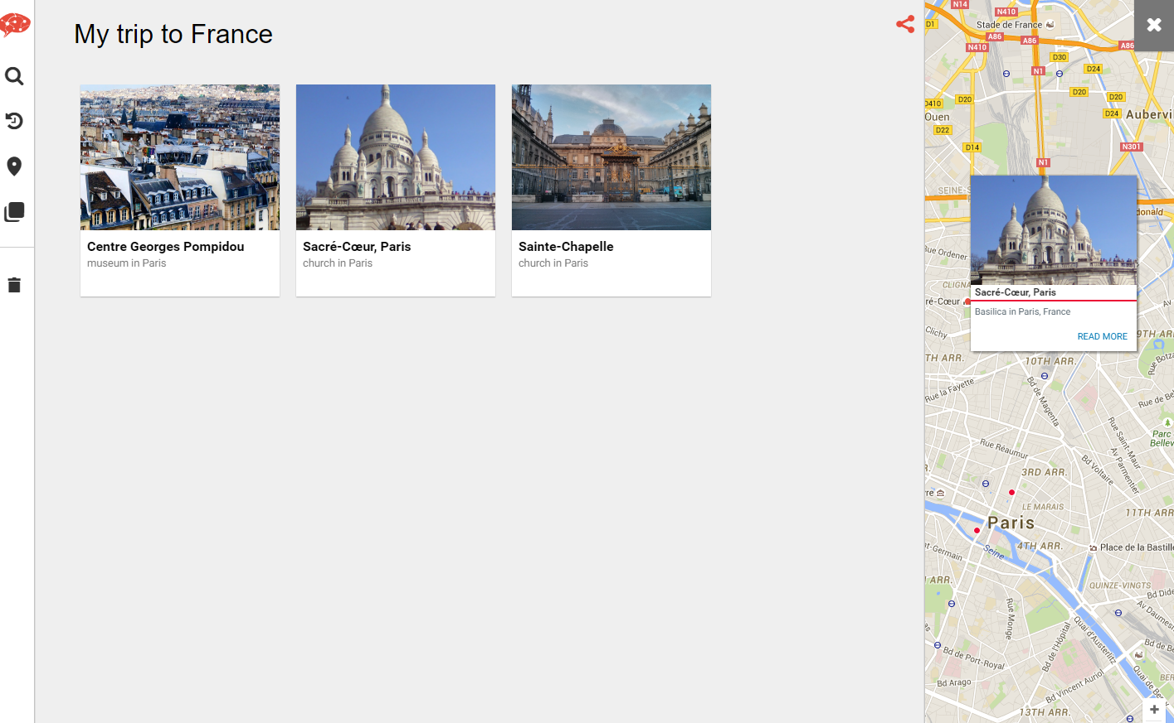

Slide 11
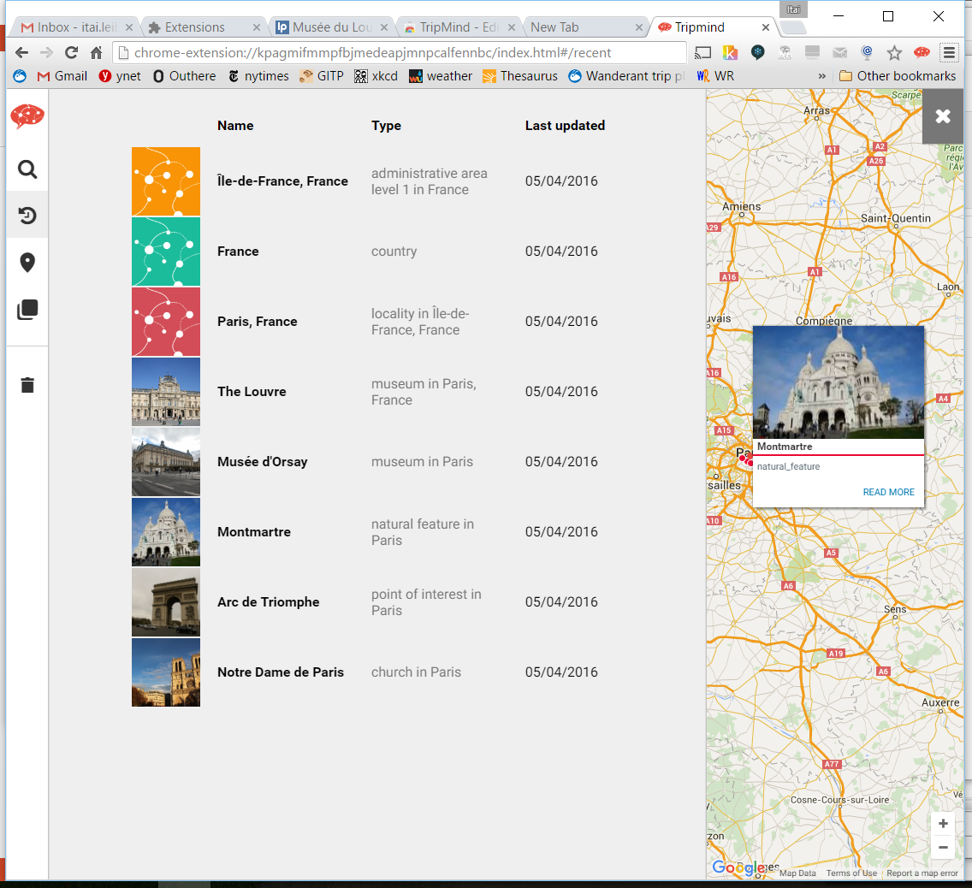

Slide 12
